Slide 1

Vel Tech Rangarajan Dr. Sagunthala R&D Institute of Science and Technology
School of Computing
Department of Computer Science and Engineering
10211CS224 / FULL STACK APPLICATION DEVELOPMENT (JAVA)
PROJECT REVIEW : MILESTONE PROJECT – 1
Date: 04-03-2026
End-to-End Event Lifecycle & Ticketing Platform
SDG 4 – Quality Education
Presented By:
K.BUNNY PREETHAM– VTU26337 –23UECS1273
Courses Handling Faculty:
Dr. S . Hemamalini,M.E,Ph.D.,
Assistant Professor (senior grade)

Slide 2
INTRODUCTION
1
Background:
Traditional event management processes involve manual coordination for event planning, ticket booking, attendee registration, and payment handling. These processes are often time-consuming, unorganized, and prone to errors.
Need for the Project:
Manual event handling leads to issues such as overbooking, ticket duplication, delayed confirmations, and lack of real-time tracking. Event organizers require a centralized system to manage the complete event lifecycle efficiently.
Real-World Relevance:
With the rapid growth of digital platforms, concerts, conferences, workshops, and college events require automated ticket booking systems with secure payment integration and instant confirmation features.
System Overview:
The proposed End-to-End Event Lifecycle & Ticketing Platform is a web-based system that allows administrators to create and manage events, while users can browse events, book tickets, and receive instant confirmations. The platform automates event creation, ticket sales, user registration, payment tracking, and result analytics in a structured and efficient manner.
2
3
4
5
6
7
8
9

Slide 3
Poor coordination and tracking
Poor coordination and tracking
PROBLEM STATEMENT
1
Despite technological advancements, many event organizers still depend on spreadsheets, manual registrations, and offline ticketing methods. This results in:
Poor coordination and tracking
Errors in ticket allocation
Lack of real-time seat availability updates
Delays in payment verification
Difficulty in managing large-scale events
There is a strong need for a secure, scalable, and automated event management system that streamlines the complete lifecycle of an event — from creation to ticket sales and final reporting.
2
3
4
5
6
7
8
9

Slide 4
OBJECTIVE(S)
1
To design and develop a full-stack web-based event management system
To provide secure user authentication and role-based access
To allow admins to create, update, and manage events dynamically
To enable users to browse events and book tickets easily
To integrate automated ticket generation and confirmation
To maintain event and booking data efficiently in a database
To ensure transparency, accuracy, and real-time updates
2
3
4
5
6
7
8
9

Slide 5
PROPOSED SYSTEM
1
After analyzing the drawbacks of traditional event handling methods, a web-based End-to-End Event Lifecycle & Ticketing Platform is proposed.
The system includes:
Admin Module for creating and managing events
User Module for browsing and booking tickets
Authentication System for secure login
Ticket Booking Module for selecting and reserving seats
Database Integration to store event and booking details
Result & Analytics Module to generate booking reports
The platform ensures seamless coordination between frontend interfaces and backend logic to provide a smooth user experience.
2
3
4
5
6
7
8
9

Slide 6
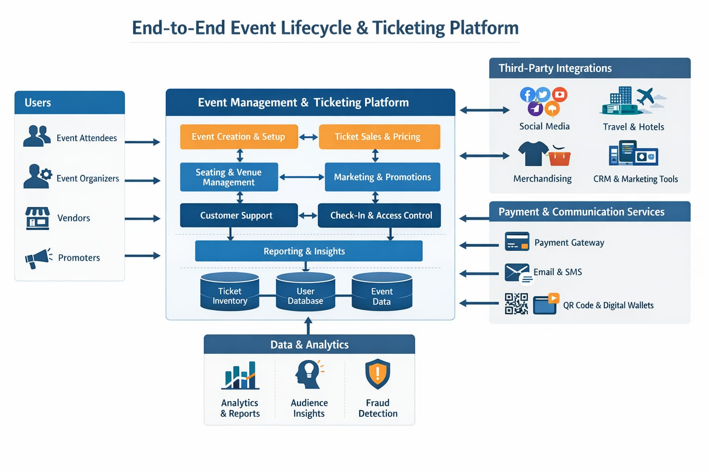
PROPOSED SYSTEM ARCHITECTURE
Input:
Admin enters event details (title, date, venue, ticket price, seat limit)
Users register, log in, and book tickets
Processing:
Backend verifies user authentication
Checks ticket availability
Processes booking request
Updates seat count in real-time
Generates confirmation
Database:
Stores user data
Stores event details
Stores ticket booking records
Maintains transaction history
Output:
Booking confirmation page
Ticket details display
Event summary report
Admin dashboard analytics
1
2
3
4
5
6
7
8
9

Slide 7
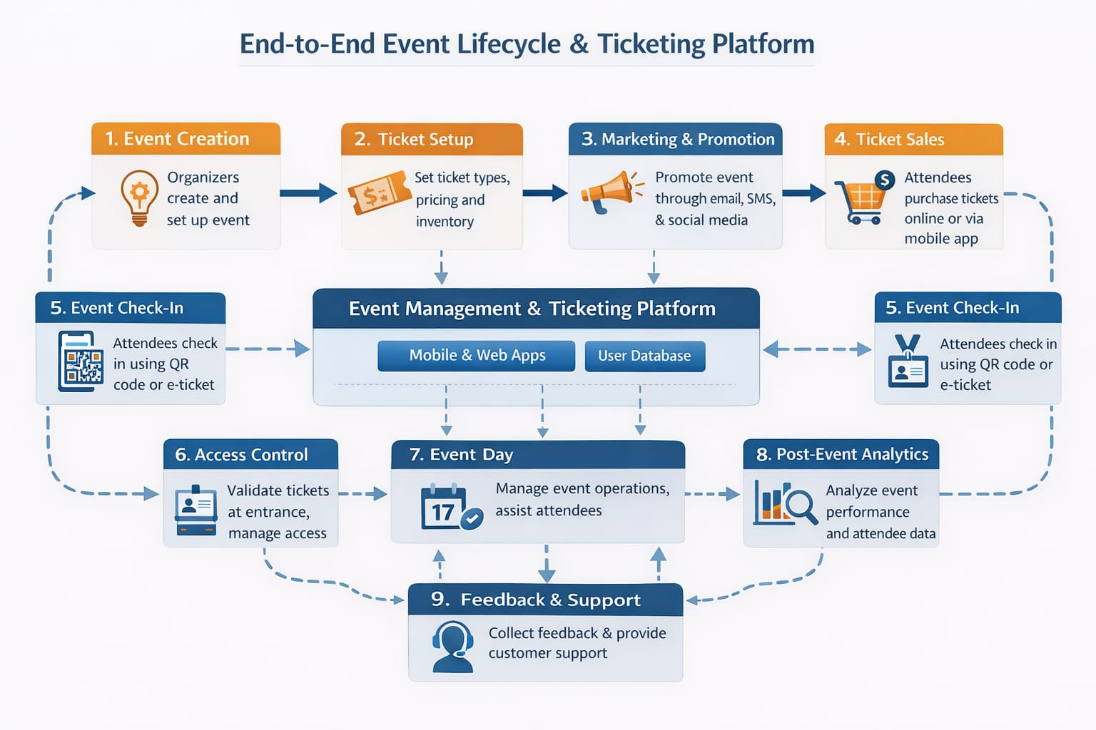
WORKFLOW
1
2
3
4
5
6
7
8
9

Slide 8
TECHNOLOGIES USED
Frontend:
HTML
CSS
JavaScript
Backend:
Java (Spring Boot) / Python (Flask)
Database:
MySQL
Tools:
Visual Studio Code
XAMPP / MySQL Workbench
Web Browser
Hardware / Software Requirements:
Minimum 4GB RAM
JDK / Python installed
MySQL Server
1
2
3
4
5
6
7
8
9

Slide 9
MODULE DESCRIPTION
Module 1: User Authentication Module
Handles login and registration functionality. Ensures only authorized users can access the system.
Module 2: Event Management Module
Allows administrators to add, update, delete, and manage events.
Module 3: Ticket Booking Module
Enables users to select events, check availability, and book tickets.
Module 4: Payment & Confirmation Module
Handles payment processing and generates booking confirmation.
Module 5: Reporting & Analytics Module
Generates event reports, ticket sales summaries, and booking statistics.
1
2
3
4
5
6
7
8
9

Slide 10
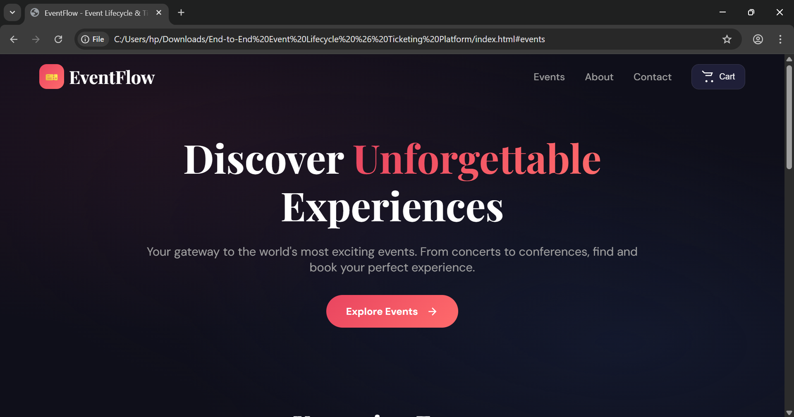
IMPLEMENTATION SCREENSHOTS
1
Login page :
The Login Page serves as the entry point to the End-to-End Event Lifecycle & Ticketing
Platform. It ensures secure access to the system for both administrators and users.
2
3
4
5
6
7
8
9

Slide 11
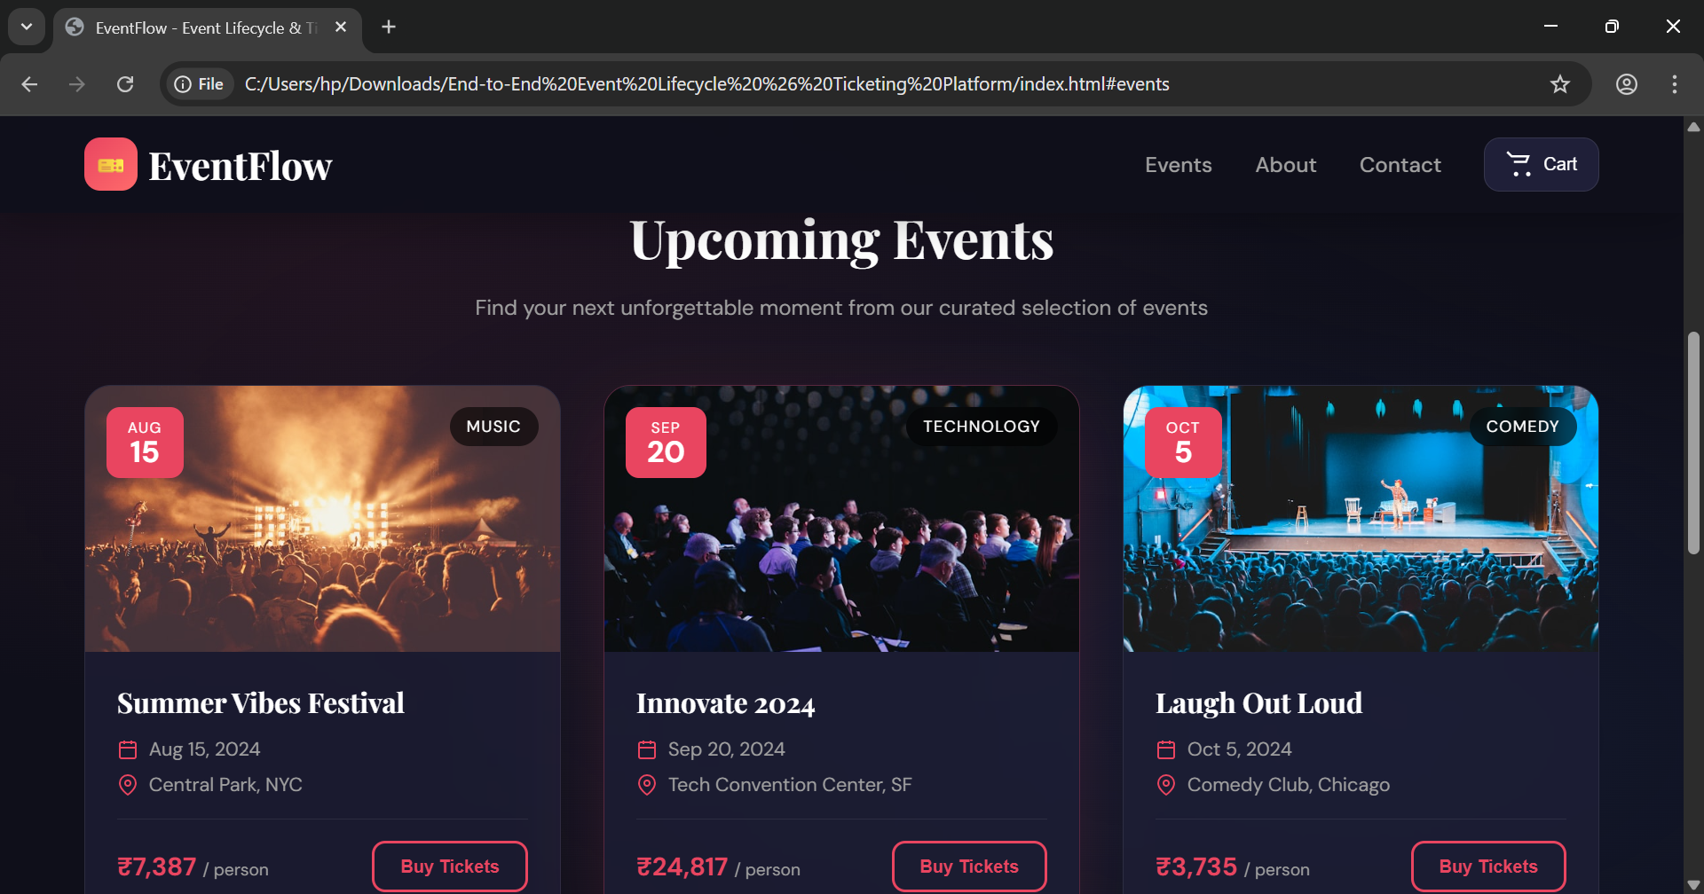
IMPLEMENTATION SCREENSHOTS
Dashboard Page :
The Dashboard Page is the main interface displayed after successful login. It provides users with an overview of available events and quick access to booking features.
1
2
3
4
5
6
7
8(A)
9

Slide 12
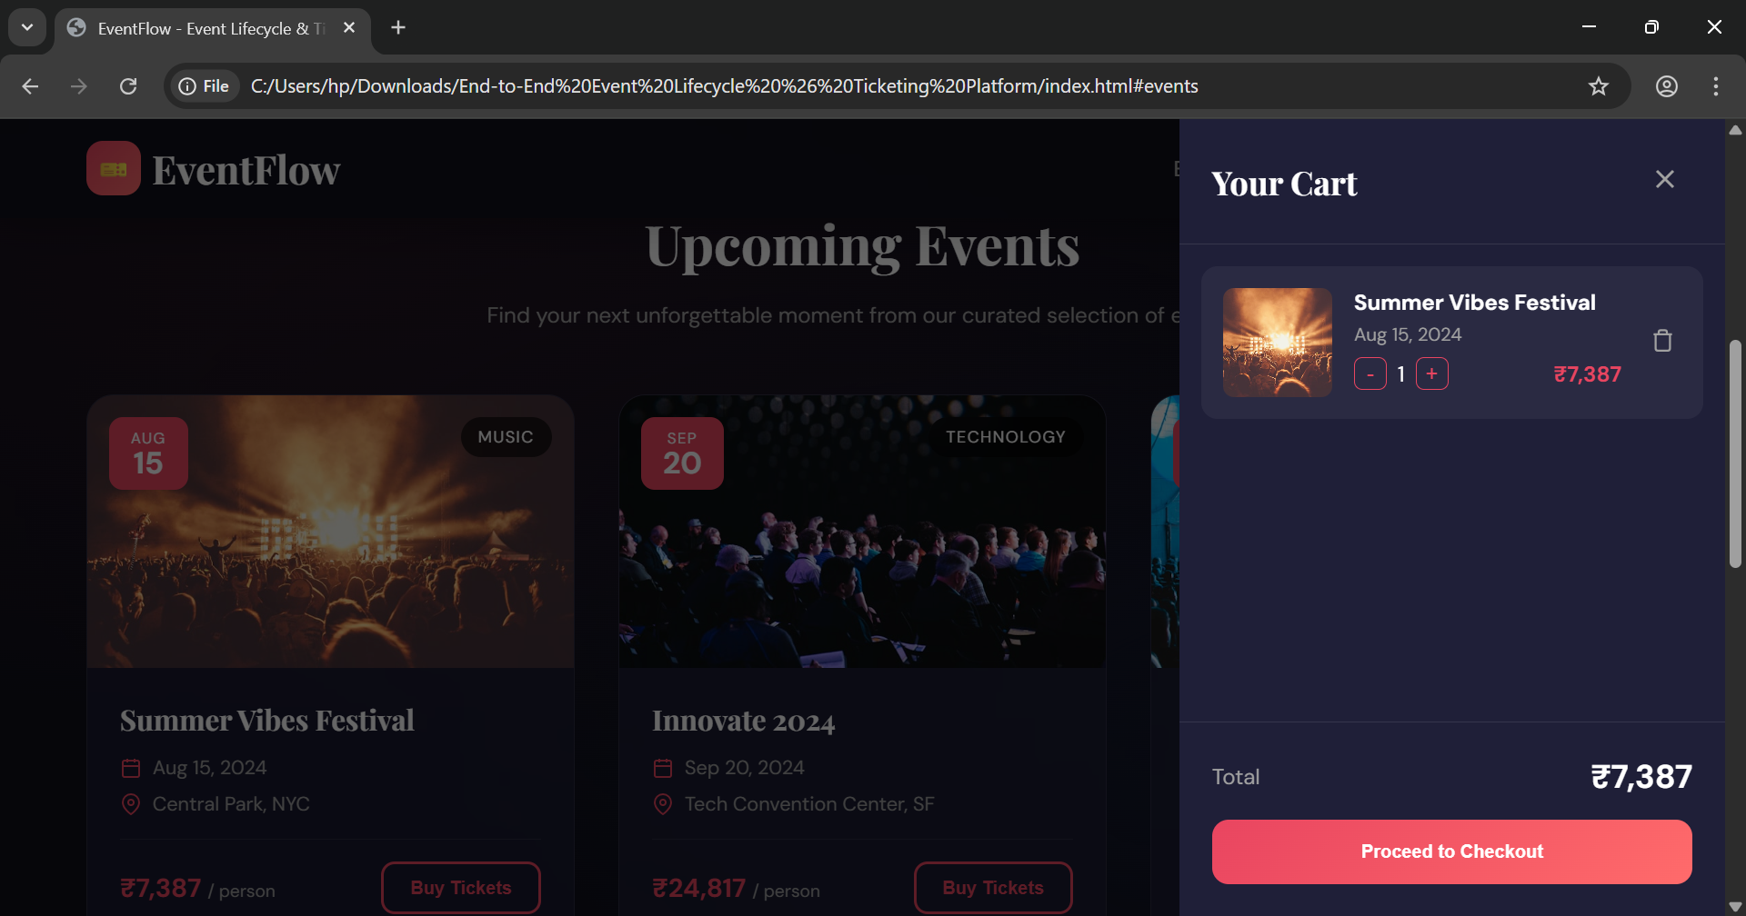
IMPLEMENTATION SCREENSHOTS
Cart Page :
The Cart Page allows users to review selected tickets before proceeding to payment.
1
2
3
4
5
6
7
8(B)
9

Slide 13
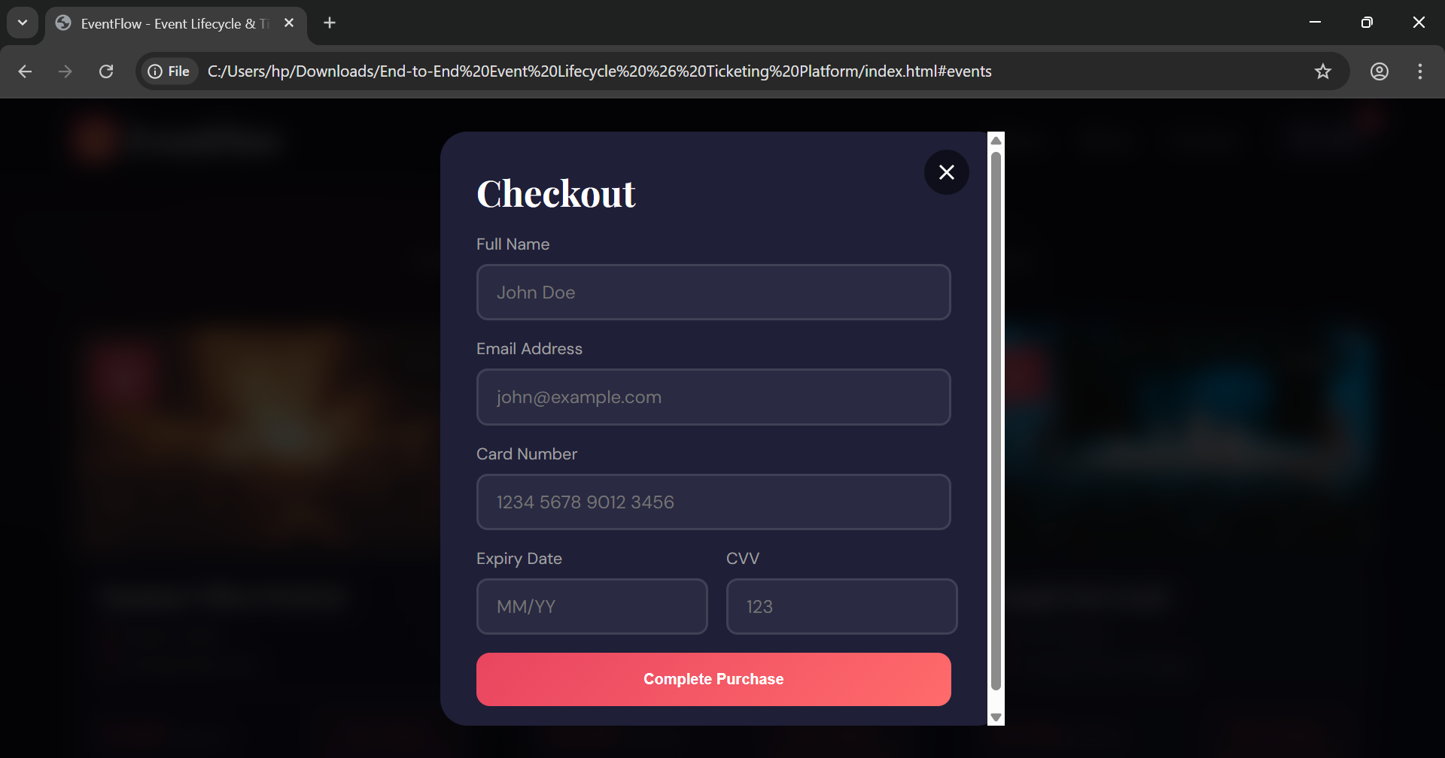
IMPLEMENTATION SCREENSHOTS
Checkout Page :
The Checkout Page allows users to securely enter payment details and complete their ticket booking.
1
2
3
4
5
6
7
8(C)
9

Slide 14
ADVANTAGES & LIMITATIONS
1
Advantages
Real-time ticket availability
Secure user authentication
Automated booking confirmation
Centralized event management
Scalable and efficient
Limitations
Requires internet connectivity
Payment gateway integration needed for real-time transactions
Security depends on proper backend implementation
2
3
4
5
6
7
8
9

Slide 15
Thank you

